Slide 1
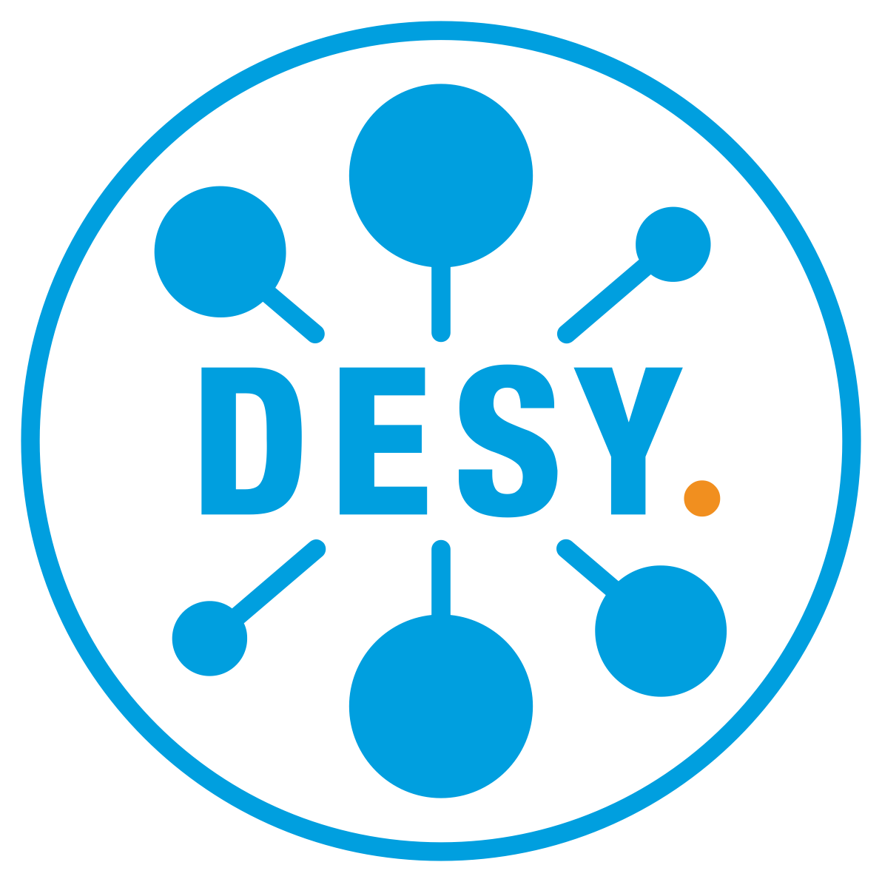


From Resilience to QoS
Albert L. Rossi (FNAL)
Notes:
Today I would like to present some work we have undertaken to enhance dCache's capacity to respond to Quality of Service (QoS) requirements. This work is ongoing. About 2/3 of the refactoring I will be presenting is already committed to the code base, but there is as yet no definite timeline for when the new capabilities will be available. Soon.

Slide 2
From Resilience to QoS
The Resilience subsystem achieves data durability by maintaining permanent disk replicas independently of tertiary storage.
dCache installation must be partitioned into resilient/non-resilient pool groups.
Seen from QoS perspective, this also looks like (static) maintenance of faster access for a subset of files.
Notes:
Some of you are undoubtedly familiar with the Resilience service. Just to remind you: this dCache subsystem is responsible for achieving data durability (preventing data loss) for disk-only deployments. Within a given installation, the pool groups and storage units requiring resilient management are specifically marked as such (in other words, Resilience rests on an explicit partitioning of the dCache configuration). From the perspective of QoS, however, Resilience looks not only like a way to achieve data durability, but also data accessibility: that is, keeping certain classes of data on disk for faster access.

Slide 3
From Resilience to QoS
The Resilience service is potentially extensible to other QoS transitions, but currently its implementation creates obstacles.
Working goals:
Transform into a set of QoS components, retaining Resilience functionality but no longer requiring data segregation into resilient vs non-resilient.
Separate layers in a way allowing for extension, preparing for a full-fledged "Engine" in which files can be transitioned between QoS classes/states based on rules.
Notes:
And in fact, much of the underlying concept and design of the Resilience service can be generalized to include other QoS transitions. Discussion about moving in this direction has been taking place for a while. The implementation of Resilience, however, prevented its easy extension to a broader QoS system. To achieve this, we needed to remove the partitioning of resilient from non-resilient data, and pry apart several of its layers into clearly distinguishable components or APIs, in order then to be able to place on top of this a rule engine for defining how sets of data or even individual files are to be treated.

Slide 4
Resilience Component Responsibilities
Resilience Message Handler
Internal State Maps
Pool Operation
File Update, Operation
Responsible for maintaining required number of replicas on disk, even when pools go offline or come back online.
Tight integration dictated by this limited purpose, desire to maximize time/space efficiency.
Later discovered issues requiring us to break this tight integration.
Those modifications now permit the complete separation into independent components.
Notes:
The bird’s-eye-view at the top of this slide represents the main components of Resilience responsible (on the left) for processing individual files and (on the right) for checking the consistency of data on a pool-by-pool basis when changes of state occur (pools go offline or come back online). All of this has been fairly tightly coupled (for reasons of optimization), but over the course of several years of experience running Resilience, we discovered a few issues whose remedy required breaking some of the original constraints, so that now it makes perfect sense to go ahead and separate out the main components into independent services.

Slide 5
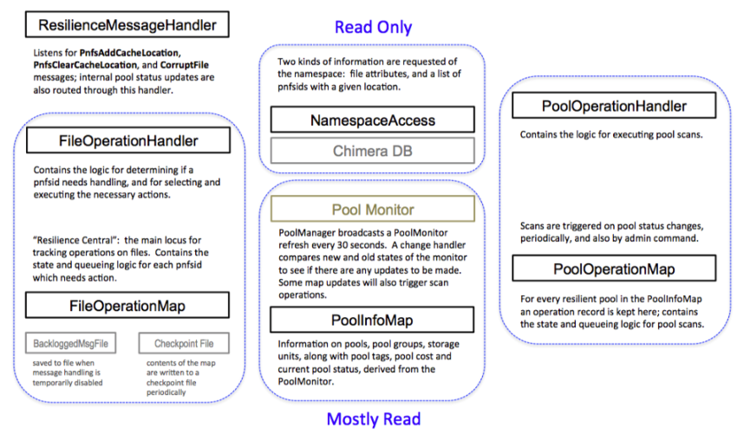
Resilience Component Responsibilities
process incoming updates from namespace
store data about state
1. how many replicas are
required?
(2) + Pools
intercept pool status changes
schedule periodic scans
(1)
(4)
(1)
2. how many replicas are currently accessible?
(4)
(3) + Pools
3. make the necessary adjustments
(3)
(2)
(1)
(4)
4. react to a change in pool state or periodically
verify for consistency
Notes:
Looking in a little more detail at the parts of Resilience and what they do.
As in the preceding diagram,
+ The left has to do with processing incoming updates from the namespace
+ The right has to do with handling changes in pool status and with maintaining system-wide consistency
+ The middle represents the internal maps for file and pool status.
Thus
1) these are the parts involved in determining the number of required replicas
2) these check the current status of the file
3) these are responsible for copying or caching
4) these for handling pool-wide scans

Slide 6
QoS Equivalents
Receiver: receives messages concerning new files and file QoS changes.
Provider: queried by file and returns the file's requirements.
Verifier: checks the current status of a file and recommends actions, if any.
Adjuster: receives an actionable request for a single operation/transformation (STAGE, FLUSH, COPY, CACHE).
Scanner: receives messages concerning pool status changes and schedules periodic scanning of pools.
Notes:
Here we see how the adaptation of those interconnected functions in Resilience was accomplished. After some disentangling, this resulted in the five independent components listed on the left, each named in terms of their clearly defined responsibilities.
+ receiving messages (not just new locations, but also QoS transitions)
+ providing requirements
+ verifying if the requirements are met
+ making adjustments if they are not
+ scanning the system to ensure consistency

Slide 7
QoS Component Interactions
Receiver and Scanner directly converted; other components required pulling apart tightly coupled interactions.
Can be run as separate services or as single standalone service.
Verifier is the heart as in Resilience; Engine is the entry point.
Notes:
The four major components in the center of this slide can now be deployed just like any other dCache service (in single domains, combined into one or more domains). We also furnish a singleton service version where they are all directly plugged into each other (avoiding message passing).
The Engine comprises both the receiver and the provider, and acts as the entry point.
The Scanner and Engine both respond to external messages, from the namespace, RESTful API and Bulk service, and from PoolManager/PoolMonitor.
The Verifier is the internal "heart" of the QoS system.

Slide 8
QoS Request Handling (Messaging)
Receive message (cache update or QoS modification).
Check the file requirements.
Request verification.
Verify the status of the file (how many replicas, on tape, etc.) on the pools (and recontact provider on iteration).
Determine action and possibly request adjustment.
Process the task; if it fails, possibly retry.
Notify verifier of success/failure; verifier reevaluates for further action (retry, continue to new action, quit).
Remove operation and send verification/action completed message.
Notify QoS transition completed (topic).
A - the current rule engine uses the namespace and Pool Selection Unit.
B - The pool selection is done by the verifier and sent as part of the message to the adjuster; verifier keeps track of maximum running slots and only sends ready tasks to the adjuster.
C - The adjuster queues the requests, maps them to adjuster types and executes; the types call out to either the pools or the PinManager.
Notes:
This slide gives a more detailed look at the communication between these components and the rest of dCache for a given request or update.
When the message is received (1), requirements are gathered from the "Rule Engine" (2), and then relayed to the verifier (3), which reverifies, when the task begins to run, by contacting the provider and the pools (4), and on that basis determines what action, if any, is needed, sending off the request to the adjuster (5) which is responsible for copying, caching, staging or flushing (6); it reports back to the verifier (7), which iterates if there is more work to be done; if not, the operation is removed (8) and the engine notified, which then publishes on a topic (9).

Slide 9
Separation into Components
Allows easier redefinition/modification of the QoS Engine "peripherals":
Adjuster: simple tasks which rely on other parts of dCache to do the heavy lifting; clear separation of concerns will be crucial when optimized restore scheduling is in place (Lea's work/presentation).
Provider: a major motivation for this refactoring; allows for integration with a separate "rule engine".
Notes:
To summarize, the two most salient achievements of this refactoring are: first, isolation of the parts of Resilience/QoS which delegate to other dCache components the heavy lifting such as copying, flushing, restoring, and caching of files (the Adjuster) –– this will become particularly important when Lea’s work on restore optimization gets fully integrated; and second, the accommodation of new ways to define and manage QoS requirements for individual files (that is, through the concrete implementation of the Provider or “Rule Engine”).

Slide 10
Rule Engine Prototype
Uses the current combination (from Resilience) of namespace attributes (Access Latency and Retention Policy) plus membership in a storage group (storage unit) expressing the number and distribution of disk replicas, to define a set of very basic QoS classes.
Notes:
As a first step in the latter direction, we have prototyped this Provider using the current way of determining file status in Resilience: by a combination of namespace attributes having to do with accessibility (Access Latency) and durability (Retention Policy), and storage unit attributes prescribing the number and distribution of permanent disk copies.

Slide 11
Prototype Mapping of Attributes to Classes
ACCESS LATENCY | RETENTION POLICY | storage unit -required | storage unit -onlyOneCopyPer | QOS | Description
NEARLINE | REPLICA | N/A | N/A | volatile | could be removed at any time
NEARLINE | CUSTODIAL | N/A | N/A | tape | on tape; disk copy could be removed at any time
ONLINE | REPLICA | undefined, 1 | N/A | disk | persistent on disk but not written to tape
ONLINE | REPLICA | k > 1 | partitioned by tags | disk | k replicas persistent on disk but not written to tape
ONLINE | CUSTODIAL | undefined, 1 | N/A | disk+tape | persistent on disk and one copy on tape
ONLINE | CUSTODIAL | k > 1 | partitioned by tags | disk+tape | k replicas persistent on disk and one copy on tape
Notes:
This results in the following mapping to four broad QoS classes:
+ volatile (temporary, scratch-like data)
+ tape (not guaranteed to be on disk)
+ disk (but not on tape)
+ disk + tape
Note that the 'disk' class covers 1:K number of replicas. I will return to this momentarily.

Slide 12
Rule Engine Prototype
On this basis, the following transitions are made available.
These can be requested for single files and for bulk sets through a RESTful API (dCache Frontend service).
Notes:
On the basis of these classes, we have made available a limited set of transitions between them which can be triggered via a RESTful API (implemented by the dCache Frontend and Bulk services).

Slide 13
Prototype Transitions and Implementation
QOS TRANSITION | CHANGE IN NAMESPACE | WHAT HAPPENS
volatile => disk | NEARLINE REPLICA => ONLINE REPLICA | k replicas are copied or made “sticky”
volatile => tape | NEARLINE REPLICA => NEARLINE CUSTODIAL | file is migrated to tape-backed pool, if necessary, and then flushed
volatile=>disk+tape | NEARLINE REPLICA => ONLINE CUSTODIAL | file is migrated to tape-backed pool, if necessary, and then flushed; k replicas are copied or made “sticky”
disk => tape | ONLINE REPLICA => NEARLINE CUSTODIAL | file is migrated to tape-backed pool, if necessary, and then flushed; all replicas are cached
disk => disk+tape | ONLINE REPLICA => ONLINE CUSTODIAL | file is migrated to tape-backed pool, if necessary, and then flushed
tape => disk | NEARLINE CUSTODIAL => ONLINE REPLICA | NOT SUPPORTED
tape => disk+tape | NEARLINE CUSTODIAL => ONLINE CUSTODIAL | LOCALITY = ONLINE_NEARLINE (file is on disk): k replicas are made sticky or copied if not enough cached replicas already exist
tape => disk+tape | NEARLINE CUSTODIAL => ONLINE CUSTODIAL | LOCALITY = NEARLINE (file not currently on disk): file is staged from tape; k replicas are copied
disk+tape => tape | ONLINE CUSTODIAL => NEARLINE CUSTODIAL | all replicas are cached
disk+tape => disk | ONLINE CUSTODIAL => ONLINE REPLICA | NOT SUPPORTED
"bring online"
Notes:
Here you can see that the request transition triggers
+ a change in the file attributes in the namespace
+ along with the necessary copying, caching, flushing to the backend or restoring to disk.
+The most useful of these transitions for most experiments I would imagine is the tape => disk + tape for files not currently on disk (third from bottom); that is, what is normally called bringonline, stage or pre-stage.
Note also in the case of a transition from tape to disk+tape, if the storage unit specifies more than one disk replica, these will be immediately produced along with the restore. Similarly, going from disk+tape to tape will cache all disk replicas.

Slide 14
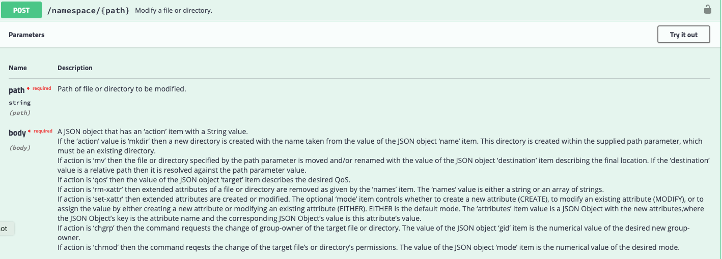
Rule Engine Prototype
(from our Swagger page: https://host:3880/api/v1)
Notes:
This is the single file path modification available through the namespace resource.

Slide 15
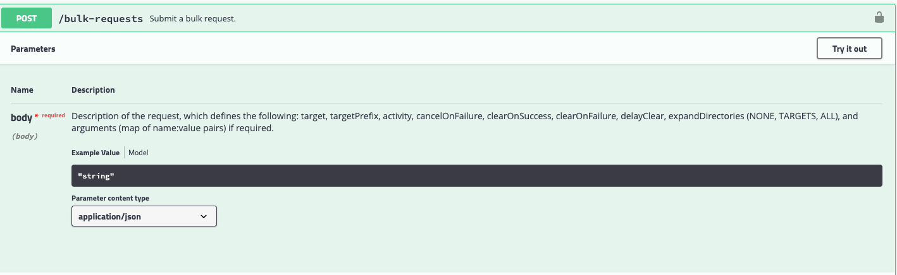
Rule Engine Prototype
{'activity':'update-qos','target':'/pnfs/fs/usr/arossi/analysis-1', 'expandDirectories':'ALL','arguments':{'target-qos':'disk+tape'}}
(from our Swagger page: https://host:3880/api/v1)
Notes:
This is the modification of QoS in bulk. The bulk request takes a list of targets, plus arguments, in this case specifying the transition.
Note here I have given an example for how to stage an entire directory of files.

Slide 16
Rule Engine Prototype Limitations
Only the namespace attributes can be changed dynamically for single files (via a query); the number of copies is statically defined by storage unit.
No provision for indicating the number or distribution of copies that should reside on tertiary storage.
No component which could be given time-based rules concerning how and when an individual file’s QoS should be changed.
Overcoming the coarseness of these semantics will be a major goal for future dCache QoS development.
Notes:
This prototype is, of course, limited. Only the namespace attributes can be changed for individual files; their number of copies still depends on a global, static storage unit definition which can only be changed through system configuration. Also, it does not support storage on multiple tertiary systems at the same time. Finally, and most significantly, there is no way of expressing automated changes triggered according to a set of rules or conditions, possibly temporal.
Adding these features will be the next steps in dCache QoS development.
QUESTIONS?

